Slide 1
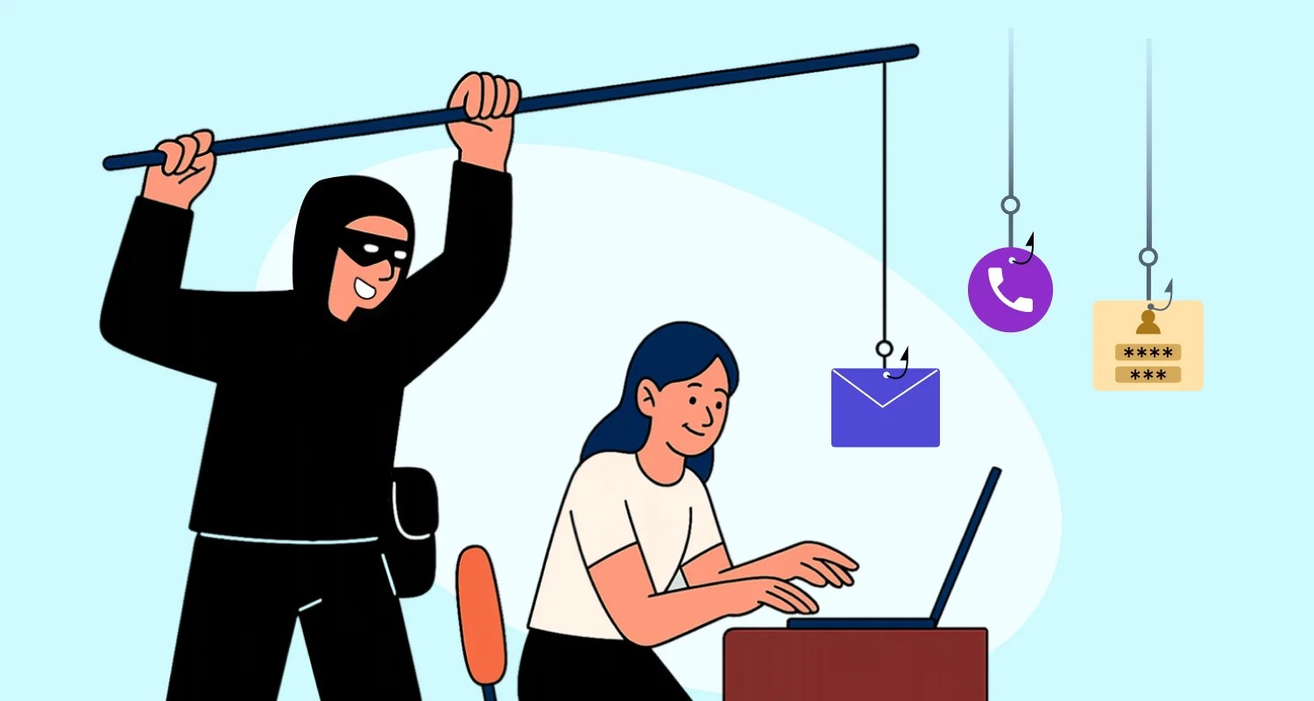
Phishing Awareness Training & Defense Strategies
Identifying Social Engineering, Email Spoofing, and Preventive Controls
Presenter: Durgesh Yadav Organization: CodeAlpha Cybersecurity Internship

Slide 2
Introduction to Phishing Attacks
What is Phishing?
Definition: A form of social engineering where attackers impersonate trustworthy entities via email, SMS, or websites to steal sensitive credentials or deploy malware.
Core Objective: Exploiting human trust and psychological triggers rather than technical system vulnerabilities.
Primary Channels:
Email Phishing: Mass distribution of deceptive emails.
Spear Phishing: Targeted attacks customized for a specific individual or organization.
Smishing / Vishing: Phishing delivered via SMS text messages or voice calls.

Slide 3
Recognizing Phishing Emails & Fake Websites
Red Flags & Technical Indicators
Sender Address Anomalies: Mismatched or spoofed domain names (e.g., support@paypa1.com instead of support@paypal.com).
Suspicious URLs: Hyperlinks pointing to unrecognized IP addresses or altered domain names (typo squatting).
Urgent / Threatening Tone: Demands immediate action with threats of account suspension, legal trouble, or financial loss.
Generic Greetings: Use of impersonal salutations such as "Dear Customer" instead of your name.
Malicious Attachments: Unsolicited files with dangerous extensions (.exe, .zip, .xlsm, .iso).

Slide 4
Social Engineering Tactics Explained
Psychological Triggers Used by Attackers
Authority: Impersonating executives (CEO fraud), IT admins, or government agencies to compel obedience.
Urgency & Fear: Creating artificial time constraints to prevent critical thinking and bypass verification routines.
Greed & Curiosity: Offering fake rewards, financial refunds, or exclusive access to entice link clicks.
Pretexting: Creating a fabricated scenario (e.g., "Urgent Security Verification Required") to extract sensitive data.

Slide 5
Real-World Case Studies
Analysis of Notable Phishing Attacks
Example 1: The Corporate Executive Scam (BEC)
Scenario: An attacker sends an urgent request posing as the company CFO, requesting an immediate wire transfer to a vendor account.
Exploit: Authority impersonation and spoofed email headers.
Example 2: Credential Harvesting via Cloud Storage
Scenario: An email claims a document has been shared on Google Drive or OneDrive, linking to a fake login page that harvests password credentials.
Exploit: Visual cloning of legitimate portal login screens.

Slide 6
Best Practices & Defense Measures
How to Prevent & Mitigate Phishing Risks
Multi-Factor Authentication (MFA): Enforce MFA across all accounts so stolen passwords alone cannot grant access.
URL Inspection: Hover over links to verify the actual destination domain before clicking.
Out-of-Band Verification: Confirm unusual requests (e.g., financial transfers or password resets) using a separate channel (phone call or direct message).
Email Security Gateway Tools: Implement SPF, DKIM, and DMARC DNS records to block unauthorized domain spoofing.

Slide 7
Interactive Quiz & Knowledge Check
Test Your Phishing Awareness
Question 1: You receive an email from security@micros0ft.com asking you to reset your password immediately. What should you do?
A) Click the link and change your password.
B) Forward the email to your friends.
C) Delete or report the email as phishing because the domain uses typosquatting (micros0ft).
(Correct Answer: C)
Question 2: Which security mechanism helps prevent unauthorized email spoofing by authenticating sender domains?
A) Antivirus Software
B) DMARC / SPF / DKIM (Correct Answer: B)
C) Disk Encryption

Slide 8
Summary & Conclusion
Key Takeaways
Stay Vigilant: Technical filters catch many threats, but human awareness is the final layer of defence.
Verify Before Acting: Inspect sender details, links, and attachments carefully before clicking.
Report Suspicious Emails: Always notify your organization's IT/SOC team upon encountering potential phishing attempts.

Slide 9


